Slide 1

Python! Day 13
Higher order functions
Event listeners
Etch-a-sketch program
Turtle race program
Begin snake game

Slide 2
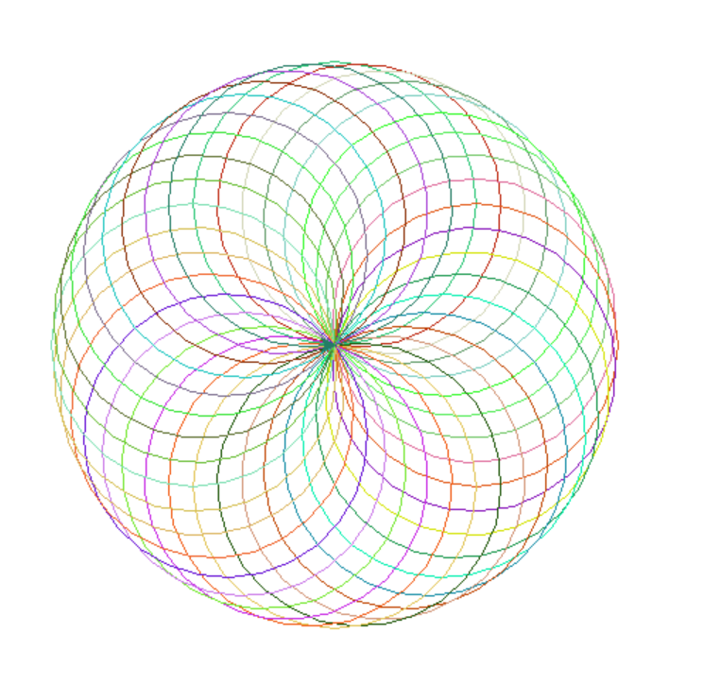
Warm-up: Spirograph
Let’s create a spirograph design
For this one, we’ll create a design with a certain number of circles overlapping with each other
All circles will have a radius of 100
Let’s also make the color change randomly between circles
For this, we’ll need to use the turtle.circle() method

Slide 3
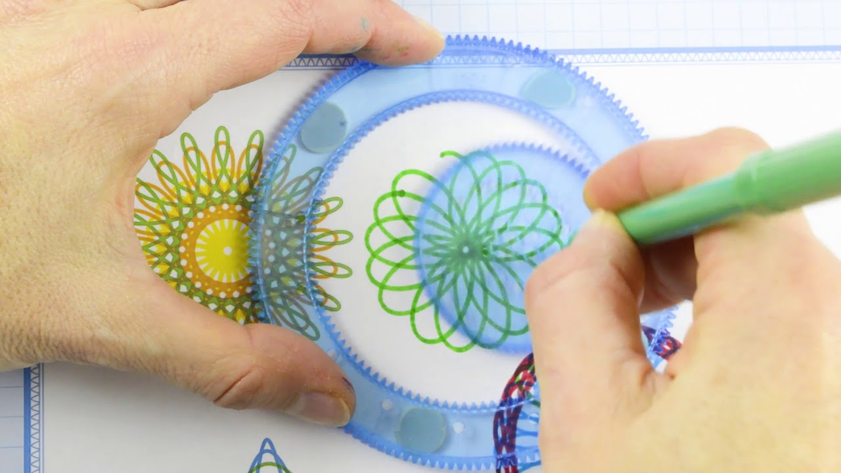
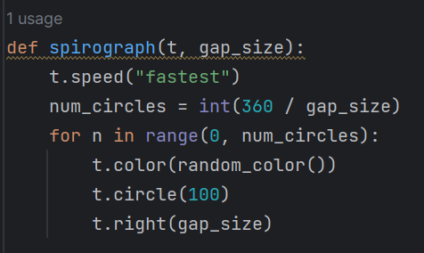
We should start by setting the speed to the fastest
Let’s make our function take the gap between the circles as an input
We can use that to calculate the number of circles the program needs to draw
Let’s also use our new random_color() function to pick a random color

Slide 4

Event Listeners
To start on this next project, let’s start by opening up a new project file
Next, let’s set up this new file so we can use the turtle
For this next project, we’ll need to learn how to use event listeners
Event listeners listen to see if the player does something like press a key so our turtle program can respond to the user
We can use event listeners to create turtle programs that the user can interact with
Eventually, we can use this to make games too

Slide 5
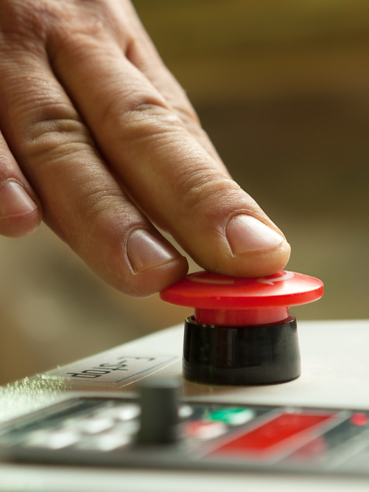
Setting Up Event Listeners
To set up an event listener, first, we need to tell the screen that it should be listening for user input
To do that, we can write:
screen_name.listen()
Now, the screen can detect user actions
Next, we need to write the code that will respond to the user’s actions
Let’s say that whenever the user presses the up arrow, we want the turtle to move forward

Slide 6

First, let’s write a function that moves the turtle forward:
def move_forward():
turtle_name.forward(10)
Next, we use the onkeypress() method of the screen
The onkeypress() method looks like this:
screen_name.onkeypress(key, function)
So, if we want to use it in this program, it will look something like this:
screen_name.onkeypress(“Up”, move_forward)
Note that we do not put parentheses after the move_forward function like normal

Slide 7
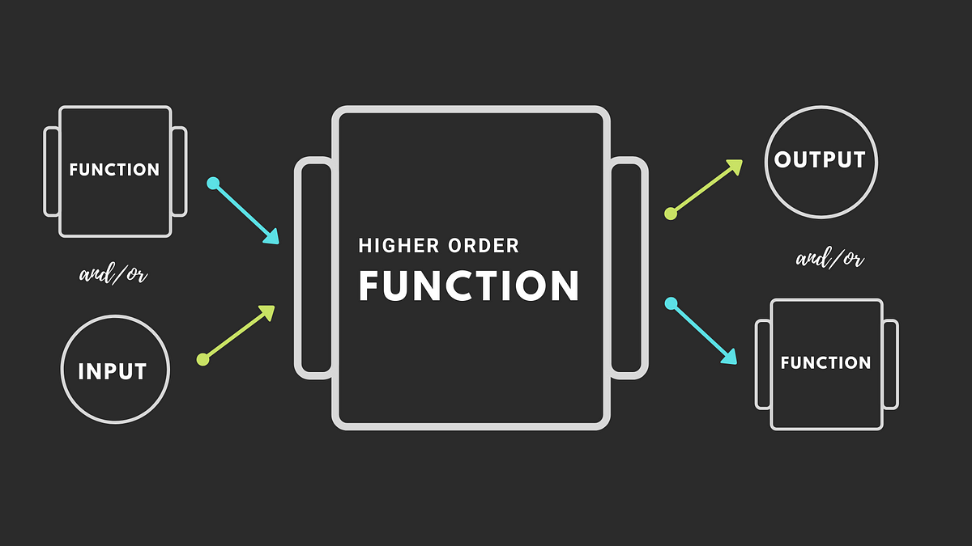
Higher Order Functions
Notice that when we write this:
screen_name.onkeypress(“Up”, move_forward)
We are using a function as an input to another function
Doing this is called using “higher-order functions”
This allows one function to call another function specified by the function’s inputs
Note that the inner function (in this case, the move_forward function) cannot have any inputs or parameters for this code to work

Slide 8
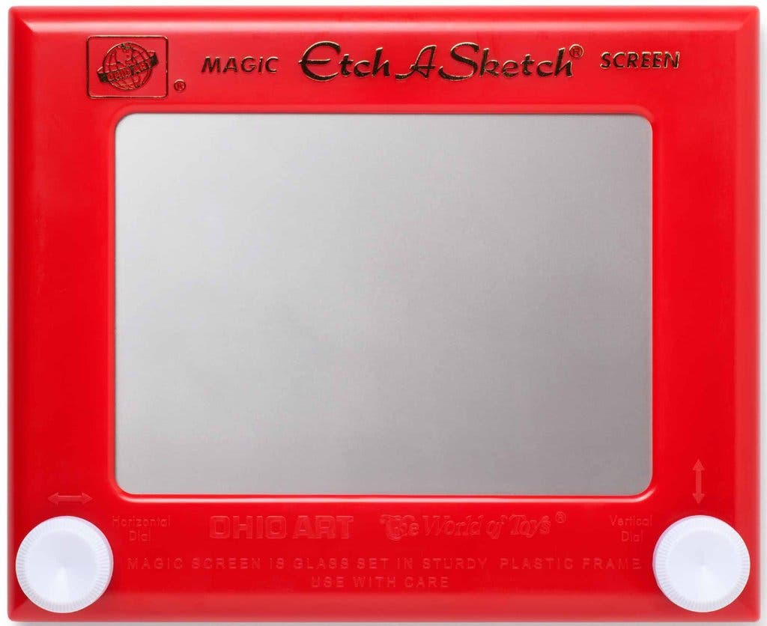
Project: Etch-a-Sketch
Now that we know how to make the turtle respond to user input, let’s put this to use and create an etch-a-sketch program
This program will allow the user to draw lines and designs with the turtle
What the user will be able to do:
Press the up arrow to move forward
Press the down arrow to move backward
Press the right arrow to turn right
Press the left arrow to turn left
Press c to clear the screen and return the turtle to the middle of the screen

Slide 9
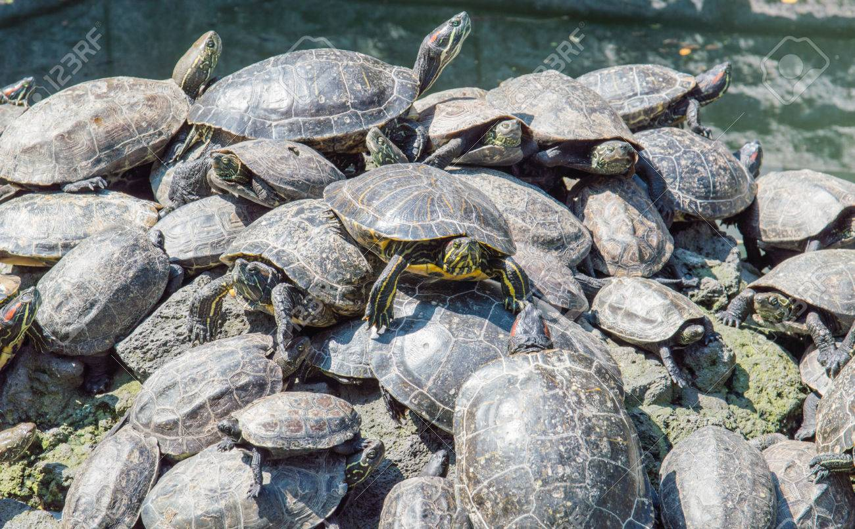
Creating Multiple Instances of an Object
We have done this before in our cat and dog project, but using a class like the turtle class, we can create many turtle objects instead of just one
For example, if we write:
tim = Turtle(“turtle”)
tom = Turtle(“arrow”)
We can create two turtles, one shaped like an arrow and another shaped like a turtle
Notice how we can change the shape of the turtle by putting the specified turtle shape as an input
This saves some time and makes our code more efficient

Slide 10
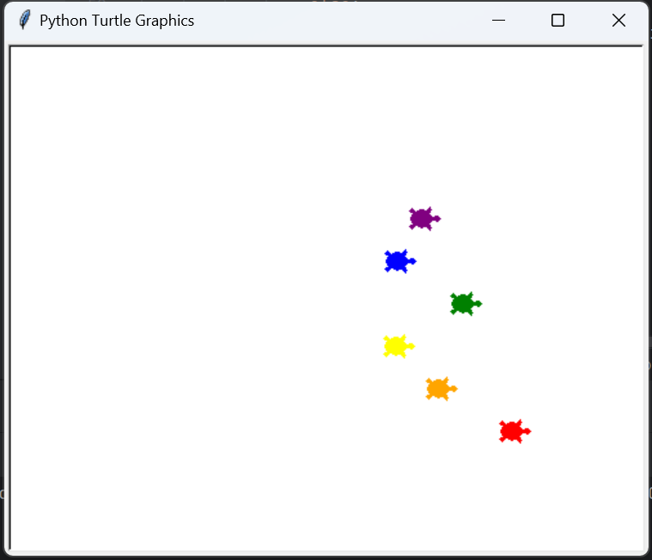
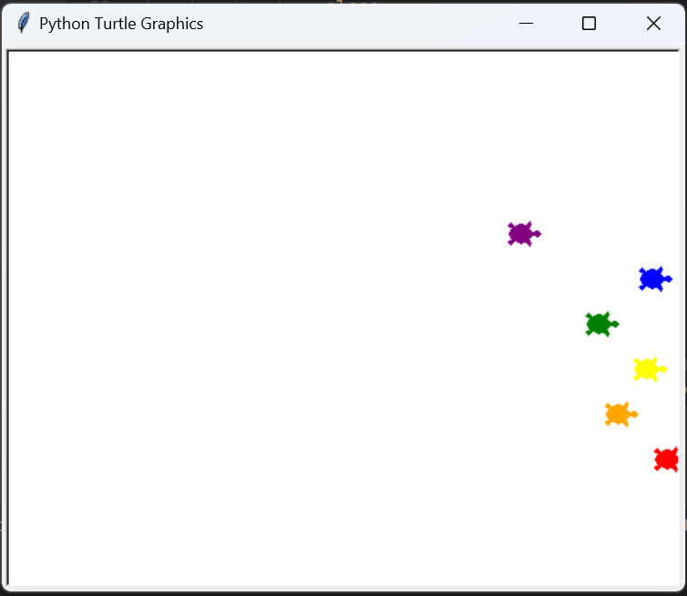
Project: Turtle Race
For the next project, let’s write a program that asks the user to bet on a turtle race and then simulates a turtle race between 6 differently-colored turtles
To start this program, let’s change the size of the screen
To do that we can use the setup() method which looks like this:
screen_name.setup(width, height)
Let’s make the screen 500 wide and 400 tall, so we can write:
screen_name.setup(500, 400)

Slide 11
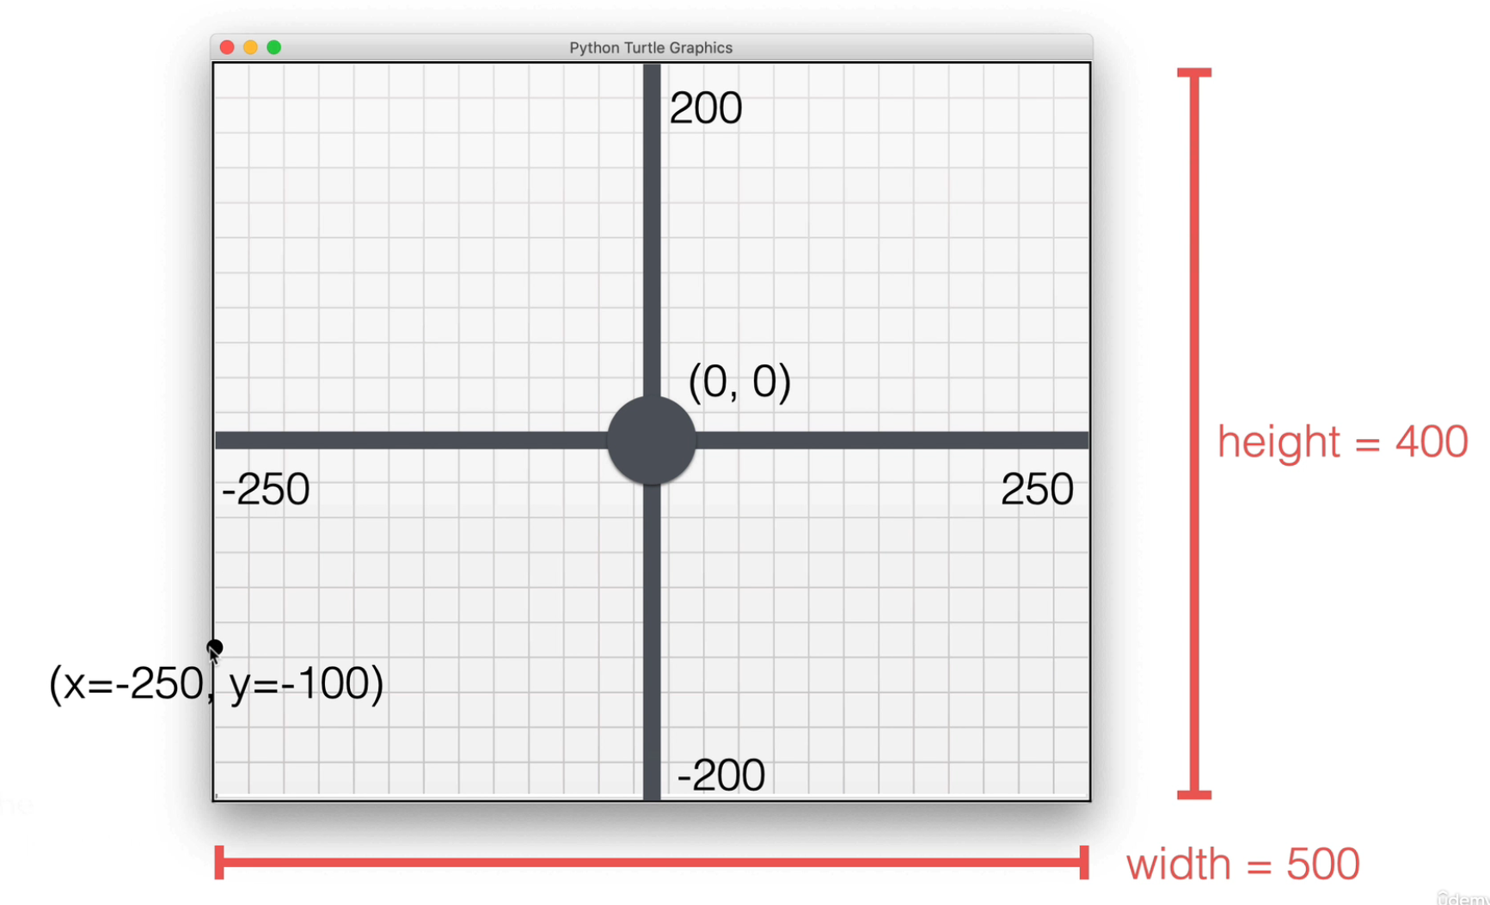
The Screen Coordinate System
To continue with this project, it will be good to understand the screen coordinate system
In this system, the middle of the screen is (0, 0), when both the horizontal and vertical positions equal 0
So, if the screen is 500 wide, the left edge of the screen would be (-250, 0) because the horizontal position is -250 and the vertical position is 0

Slide 12
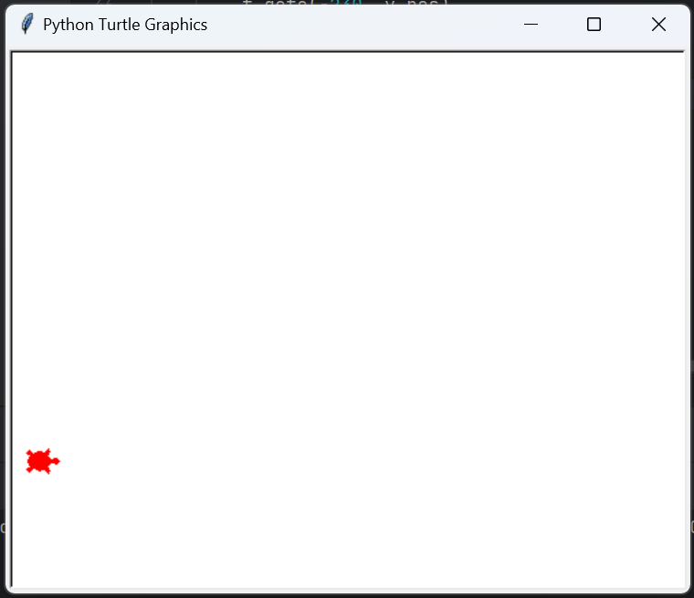
Turtle Race Continued
So, if we want our turtles to race across the screen, we should probably send them to the left side of the screen
Like this:
turtle_name.penup()
turtle_name.goto(-230, 0)

Slide 13
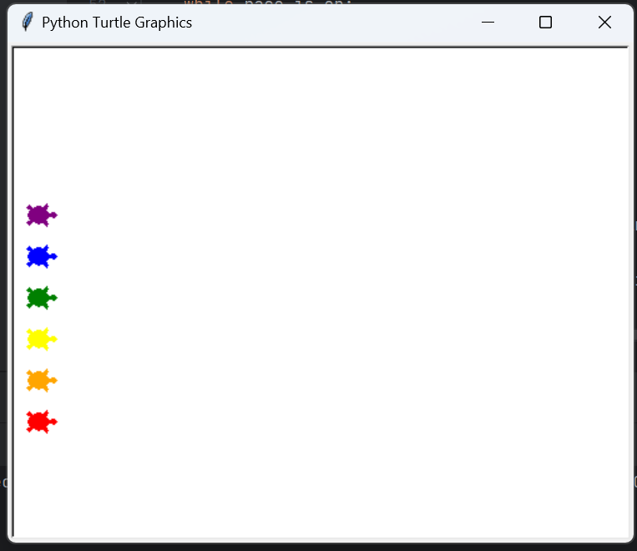
Next, for our turtle race, let’s create a list of all the turtle colors and another list to hold all of the turtles:
colors = [“red”, “orange”, “yellow”, “green”, “blue”, purple]
turtles = []
Now, let’s write a for loop to create all of these turtles:
for color in colors:
t = Turtle(“turtle”)
t.color(“color”)
t.penup()
vertical_position = 30 * len(turtles) - 100
t.goto(-230, vertical_position)
turtles.append(t)

Slide 14
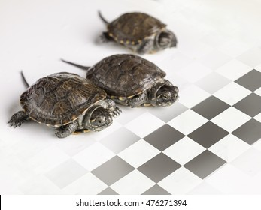
Next, let’s create a while loop that, while the race is active, randomly moves each turtle forward over and over:
race_is_active = True
while race_is_active:
for turtle in turtles:
move_distance = random.randint(0, 10)
turtle.forward(move_distance)
if turtle.position[0] >= 230:
winning_color = turtle.color()[0]
print(winning_color + “ wins!”)
race_is_active = False

Slide 15
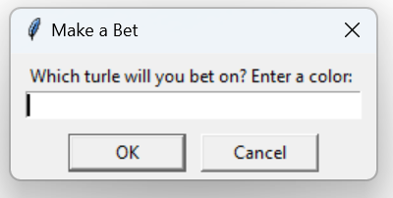
Then, we need to allow the user to bet on a turtle before the game starts
To do this, we can use the screen’s textinput() method that looks like this:
screen_name.textinput(title, prompt)
This gives the user a popup text box to type words into
For the turtle race program, we can write this:
user_bet = screen_name.textinput(“Make a Bet”, “Enter a turtle color to bet on: “)

Slide 16
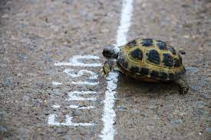
Finally, we need to tell the user if their bet was correct at the end of the race:
while race_is_active:
for turtle in turtles:
move_distance = random.randint(0, 10)
turtle.forward(move_distance)
if turtle.position[0] >= 230:
winning_color = turtle.color()[0]
race_is_active = False
if winning_color == user_bet:
print(“You win!” The “ + winning_color + “ turtle won.”) else:
print(“You lost. The “ + winning_color + “ turtle won.”)

